Slide 1
– Web Client & Server Programming –
Introduction to
Content Management Systems
Content Management Systems
Web Client & Server Programming
Day 1
CMS’s – The Basics

Slide 2
Please explore the following online materials:
– Web Client & Server Programming –
Introduction to
Content Management Systems
https://en.wikipedia.org/wiki/Content_management_system
http://code.tutsplus.com/articles/top-10-most-usable-content-management-systems--net-6493
WordPress
    http://www.wordpress.org
    http://www.wordpress.com
Drupal
    http://www.drupal.org
Blogger
    http://blogspot.ca
MySQL
    http://thenewboston.org/list.php?cat=4

Slide 3
What is a CMS?
– Web Client & Server Programming –
Introduction to
Content Management Systems
Content Management System
Web application where the website content is divorced from the look and feel of the site
Allows users with no coding experience to update website content like they are working in MS Word
Content and some config settings are stored in a Database
Changing website’s theme shouldn’t alter or break the content

Slide 4
Other CMS Features…
– Web Client & Server Programming –
Introduction to
Content Management Systems
User creation and management
    Administrator – create other users. Super user in the system
    Publisher/Editor – allowed to publish content to the live site
    Writer/Content Creator – creates text, media, and page content
    Viewer/Reader – outside user with special privileges
Permalinks/NiceUri
    Makes readable links from CMS links – better for SEO
Multiple Language Support
Staging/Working site management
Publication management
Plugins, Themes, and more.

Slide 5
WordPress
– Web Client & Server Programming –
Introduction to
Content Management Systems
Installation requirements:
  PHP, Mysql, Wordpress, apache web server (httpd)
Most hosting providers will have these ready to go
You may need to create a database in MySql.
  Login to mysql either through myPhpAdmin or on the command line
  Create database <db-name>;
  Create user ‘<username>’@’localhost’ identified by ‘password’;
  Grant all privileges on <db-name>.* to ‘<username>’@’localhost’ with grant option;

Slide 6
WordPress
– Web Client & Server Programming –
Introduction to
Content Management Systems
Default home page: http://yoursite.com/index.php
Admin page: http://yoursite.com/wp-admin
Default installation comes with:
  2 plugins (Akismet, Dolly)
  3 Themes (2015, 2014, 2013)
  No default menu (but you can easily create one)
  A default post, a default page, a default comment
  No media or default images

Slide 7
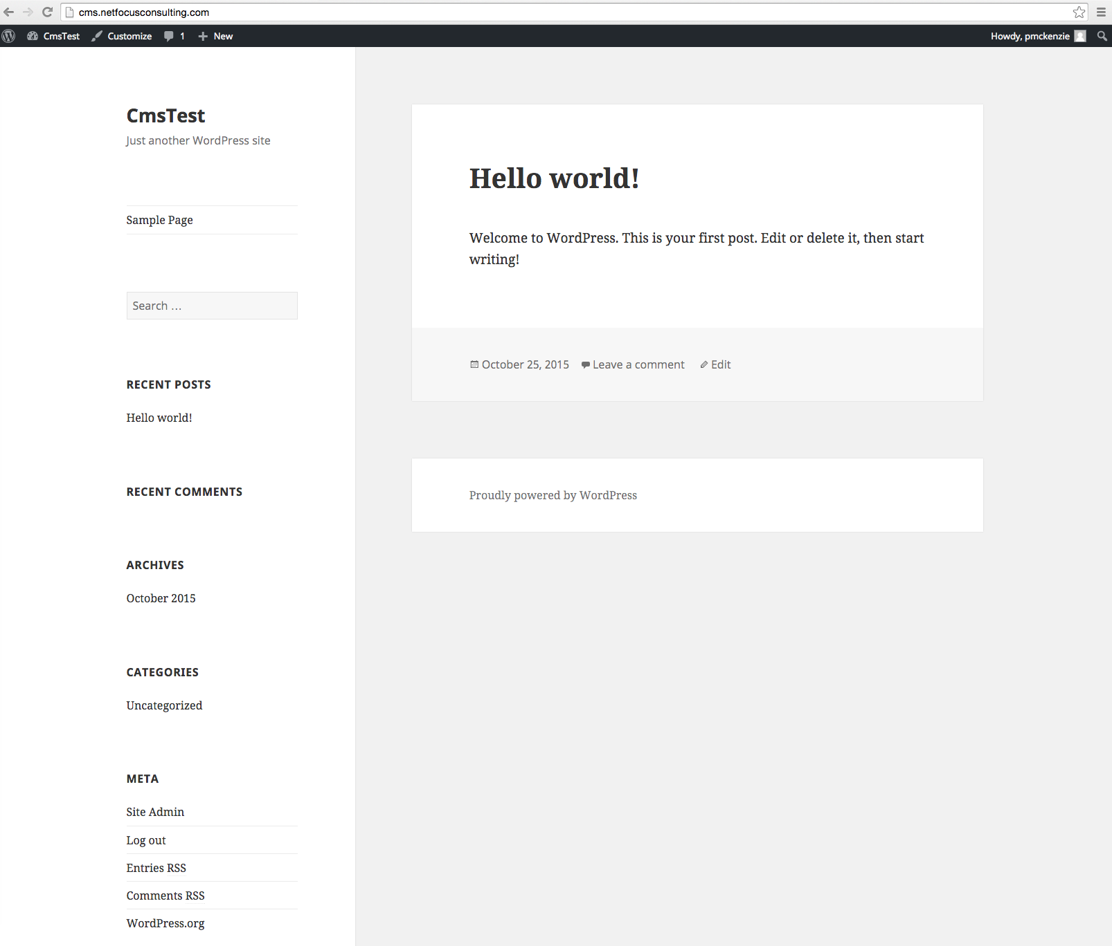
WordPress
– Web Client & Server Programming –
Introduction to
Content Management Systems

Slide 8
WordPress
– Web Client & Server Programming –
Introduction to
Content Management Systems
Once logged in as Admin…
  Dashboard is the main admin page. Tells of recent changes on the site, along with common actions, suggestion for updates and customizations
  Posts are like blog entries. You can create categories and/or tags for them
  Media – where you upload photos, sound files, and videos
  Pages – different than blog entries. Should be displayed in a menu.

Slide 9
WordPress
– Web Client & Server Programming –
Introduction to
Content Management Systems
Once logged in as Admin…(continued)
  Comments allows you to moderate comments on the blog posts. You can remove or edit the default comment from Mr. WordPress
  Appearance is for the look and feel of your site. Themes – can be free or paid for. Can be customized.
  Plugins – Add extra functionality – spam blocking, page caching, twitter feed, etc.
  Users – Add/edit users on the site. Give/revoke permissions

Slide 10
WordPress
– Web Client & Server Programming –
Introduction to
Content Management Systems
Once logged in as Admin…(continued)
  Tools – similar to Plugins.
    Import content from other WP instances
    Import content from other Blogs
    Install RSS and/or Tumblr integration
  Settings
    General – admin email contact, site title, tag line, dates
    Writing – allows you to create new posts via email
    Reading – some config for how your posts display
    Discussion – comment settings and moderation config
    Media – config how media is stored
    Permalinks – readable (also better for SEO) links

Slide 11
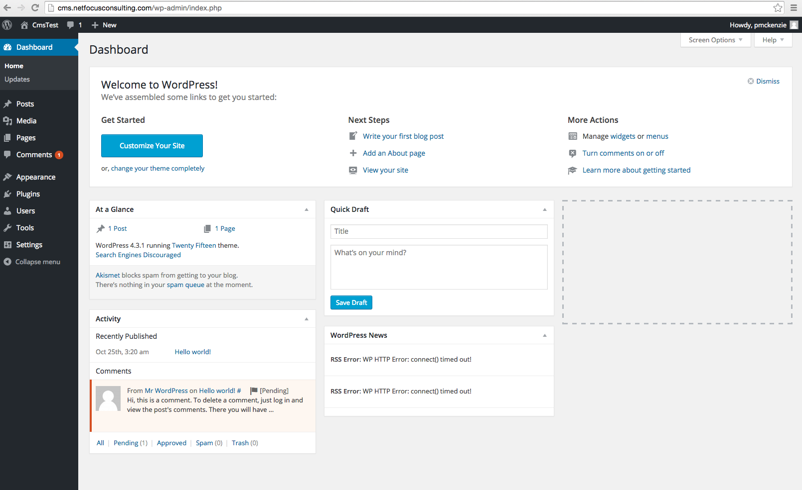
WordPress
– Web Client & Server Programming –
Introduction to
Content Management Systems

Slide 12
Thoughts on Freeware (like WP)
– Web Client & Server Programming –
Introduction to
Content Management Systems
It can be buggy
  My Infoglue issues
  My Wordpress issues (max image size, image can’t be edited)
  You get to support it yourself
  The more downloads the better
  The more downloads, the more reason to keep updated (security). Raises the risk of things breaking….

